Slide 1
DEPARTMENT OF COMPUTER SCIENCE AND ENGINEERING
Analysis and Evaluation of Stock Prices using Fuzzy Multi-attribute Decision Making Method and Sentiment Analysis.
(Domains : Data Science, Machine Learning, Cloud Computing, Cluster Computing)
Team Members:
Sripaad Srinivasan : 211716104097
Veera Raghavan G : 211716104107
Venkatraman K : 211716104108
Supervisor :
Dr. M. Geetha.
Professor, Department of Computer Science and Engineering.
Zeroth Review : 01-10-2019

Slide 2
Objective of the Project
The main objective of the project is to Develop a Stock Price Recommendation System by Analysing and Evaluating Stock Prices using a Fuzzy Multi-attribute Decision Making Method and Sentiment Analysis.
Stock market is a market that enables seamless exchange of buying and selling of company stocks. Every Stock Exchange has their own Stock Index value. Index is the average value that is calculated by combining several stocks. This helps in representing the entire stock market and predicting the market’s movement over time.
The Equity market can have a profound impact on people and the country’s economy as a whole. Therefore, predicting the stock trends in an effective manner can minimize the risk of investing and maximize profit. In our project, we are using the Time Series Forecasting methodologies along with fuzzy multiattribute decision-making methods for predicting and visualizing the predictions.
Our approach of a robust Cloud-Hadoop based data pipeline is proposed to perform analyses for any scale and type of data, in which selected stocks are analysed to predict daily gains based on real time data from Yahoo Finance and sentiments from Twitter and the News.
An Apache Hadoop big-data framework is provided to handle large data sets through distributed storage and processing, stocks from the BSE are picked and their daily gain data are divided into training and test data set to predict the stocks with high daily gains using Machine Learning modules of Spark.
Our entire setup is proposed to be robust, efficient and has a strong potential for short-term and longer term market predictions.

Slide 3
Introduction
Forecasting the stock exchange data includes an assumption that the information that is publicly available at present has some predictive relationship to the future stock returns.
Stock trend forecasting is one of the most difficult tasks to achieve in finance because of the level of volatility and various other influences on the market.
The investors in the stock market always find a technique that can guarantee easy profiting by forecasting the stock trends and minimize the risk of investing. This motivates the researchers in the domain to develop new forecasting models.
Building accurate model is difficult as variation in price depends on multiple factors such as news, social media, fundamentals and production of the company, government bonds, historical price and country’s economics.
Prediction model which considers only one factor might doomed to be inaccurate. Hence incorporating multiple factors such as news, social media data and historical price might increase the accuracy of the model.

Slide 4
Pro ectFeasibility Study
Project Feasibility Study
The aim of this project is to build an application which outputs accurate recommendations in a quantifiable manner.
For this purpose, 3 modules are implemented which are as follows:
Machine Learning module
Sentiment Analysis module
Fuzzy logic Module
Machine Learning Module data points.
Opening price of prediction day
Lowest and highest prices of the prediction day
Simple Moving Average
Exponential moving average of opening and closing prices of the prediction day
Exponential moving average of lowest and highest prices of the prediction day
Bollinger Bands of opening and closing prices of the prediction day
Bollinger Bands of lowest and highest prices of the prediction day
Sentiment Analysis Module data points.
Data Collection
Tokenizing
Lemmatizing
Feature Extraction
Classification
The activation rules for Fuzzy module.
IF the News Sentiment was good or the Stock Prediction value was good, THEN the Stock faith will be high.
IF the Stock Prediction value was average, THEN the Stock faith will be medium.
IF the News Sentiment was poor and the Stock Prediction value was poor, THEN the Stock faith will be low.

Slide 5
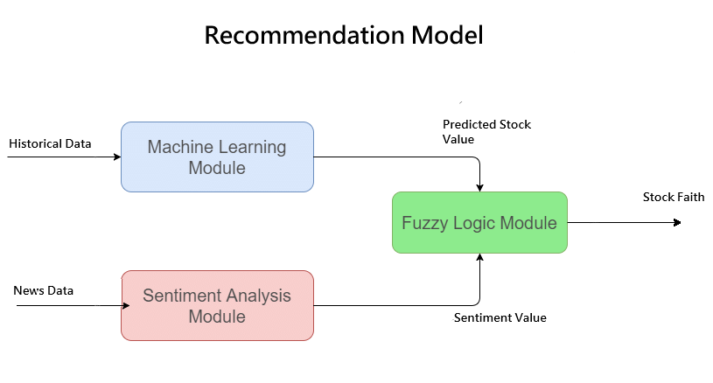
Architecture of the proposed work
Architecture of the proposed work

Slide 6
Literature Survey
Literature Survey
Stocks Analysis and Prediction Using Big Data Analytics
By Zhihao PENG , Department of Computer Science, Dalian Neusoft Institute of Information, Dalian 116626, China pengzhihao@neusoft.edu.cn
DOI : 10.1109/ICITBS.2019.00081
Date of Publication : 21 March 2019
The author Zhihao PENG has tried to develop a machine learning model to predict the future crude oil prices using the USO(The United State Oil Fund,USO) data and understand which set of features are better in prediction using Hadoop framework.
By means of studying a live stream data of US oil stock prices the author has tried to better understand how does US Oil index affects the stock price of other stocks in US oil funds exchange.
Besides it helped the author predict the profitable stocks for stock traders and provide profits to US Oil stocks trader community.

